Slide 1
Data Communication & Computer Networks

Slide 2
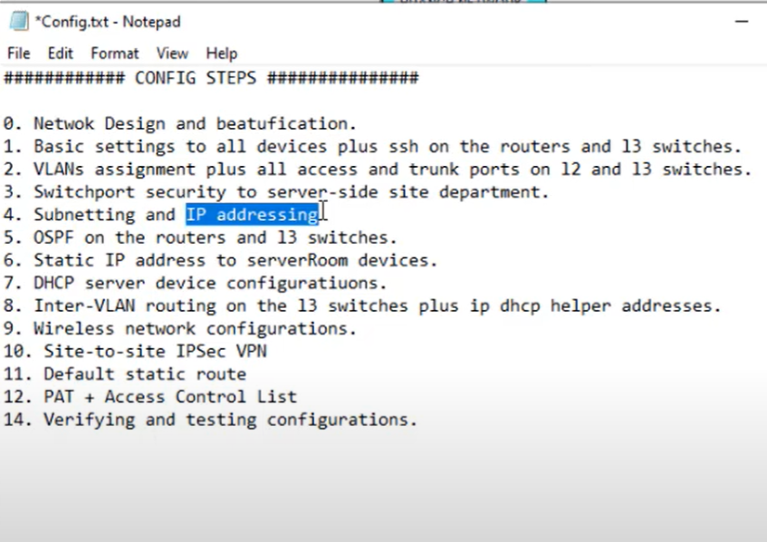

Slide 3
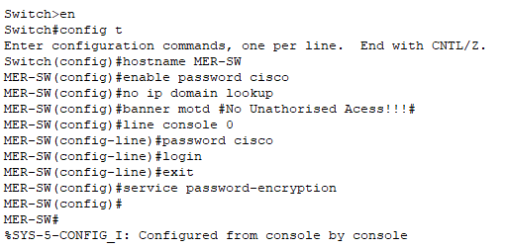
Switch configuration:(SSH & basic settings)

Slide 4
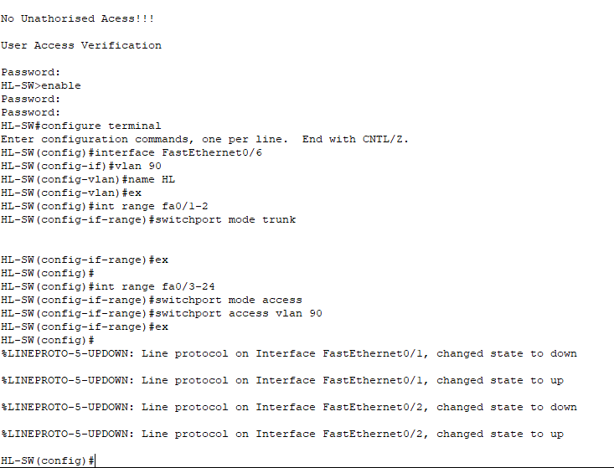
Switch configure:(VLAN assign & trunk ports)

Slide 5
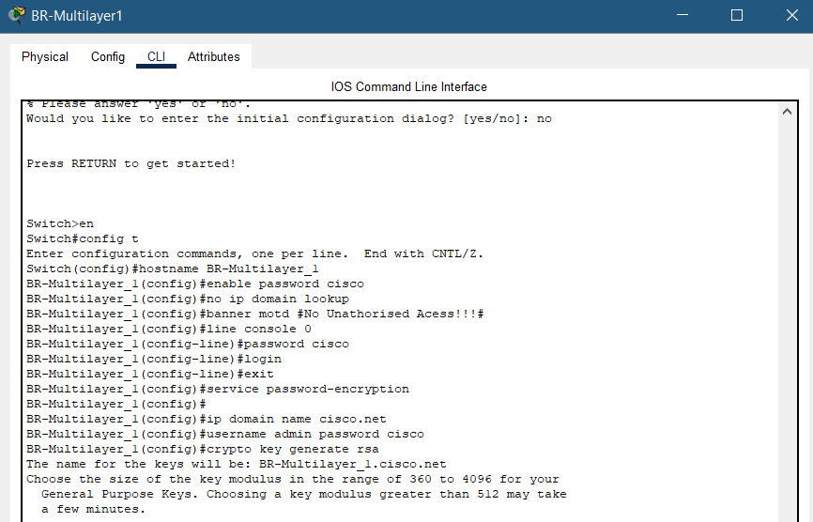
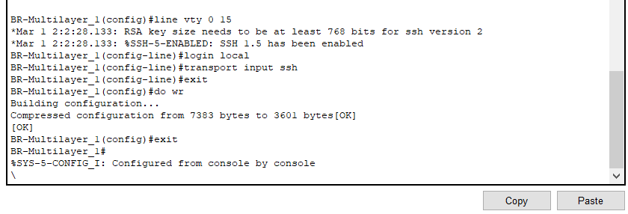
Multilayer configuration:

Slide 6
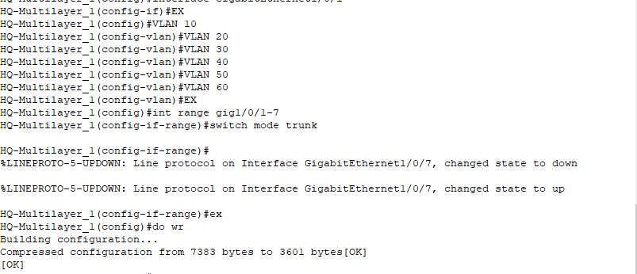
Multilayer configuration:

Slide 7
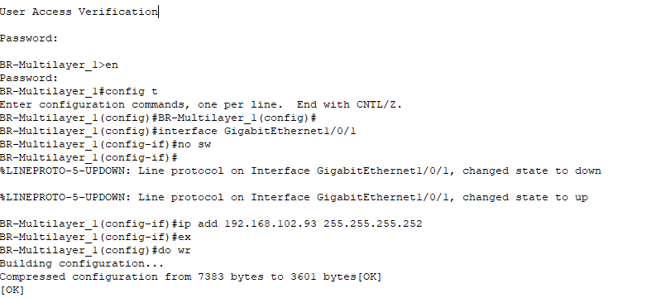
Multilayer configuration: IP address

Slide 8
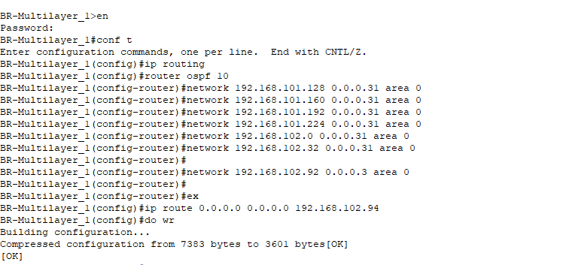
Multilayer configuration: (OSPF and static routing)

Slide 9
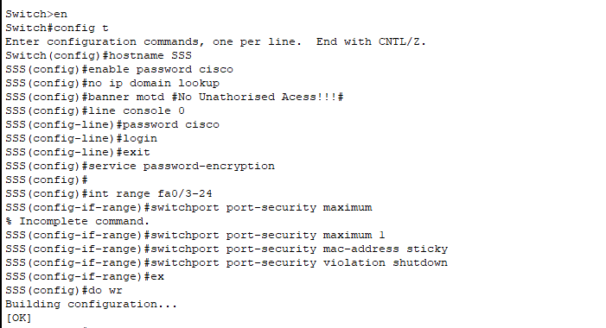
Server Side configuration: (switchport)

Slide 10
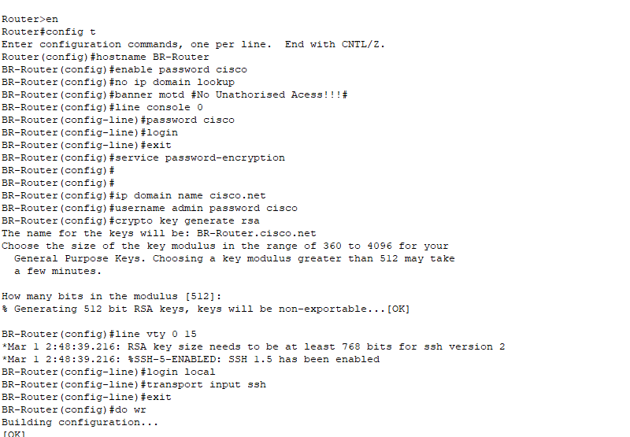
Branch Router configure:(basic setting & SSH)

Slide 11
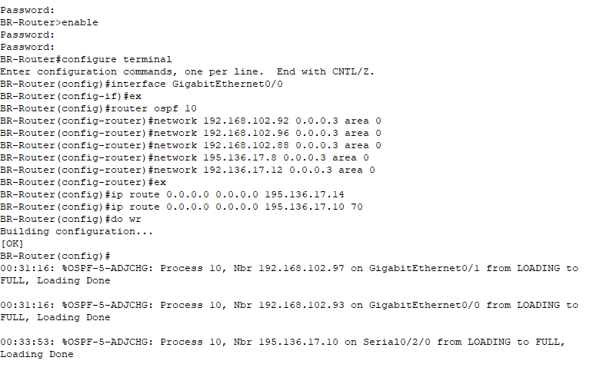
Branch Router configure:(OSPF and static routing)

Slide 12
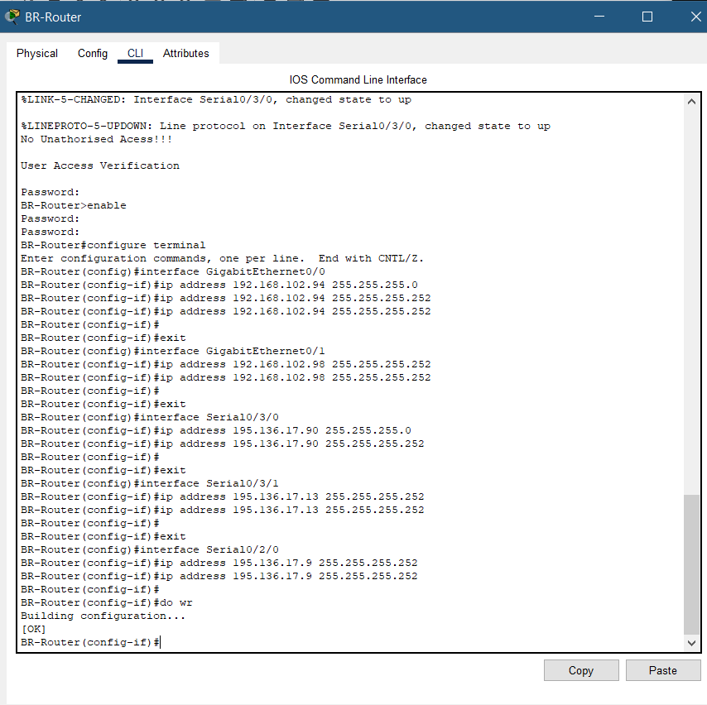
Branch Router configure:(Ip and subnetting)

Slide 13
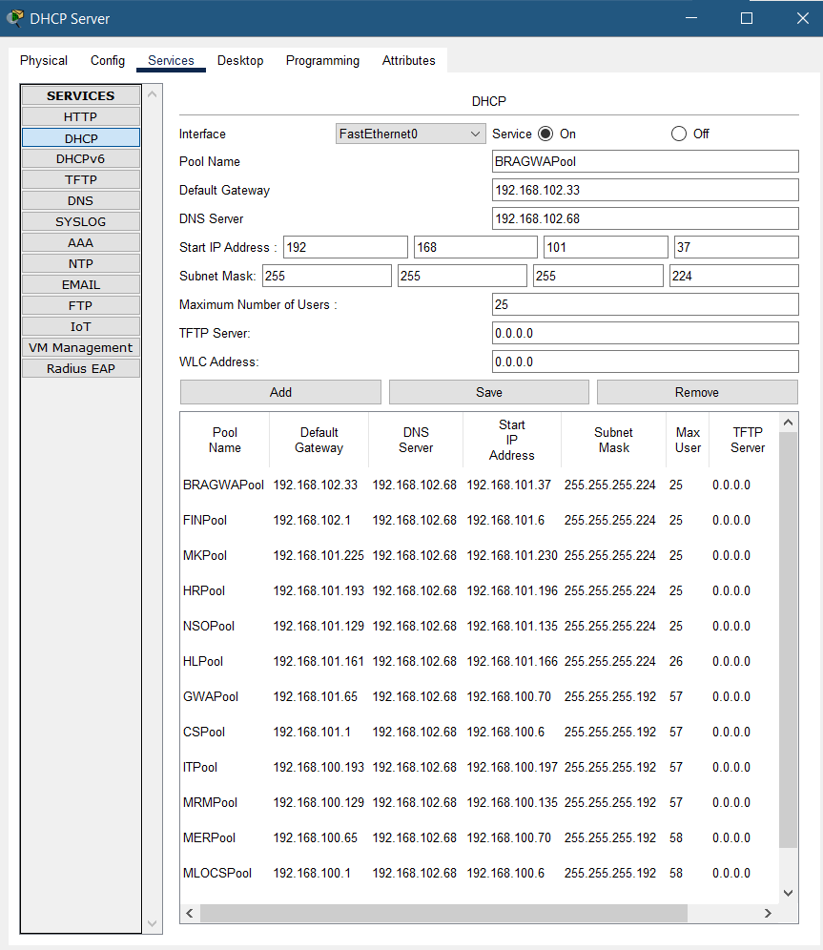
DHCP CONFIGURATION (assign IP address to all 12 department)

Slide 14
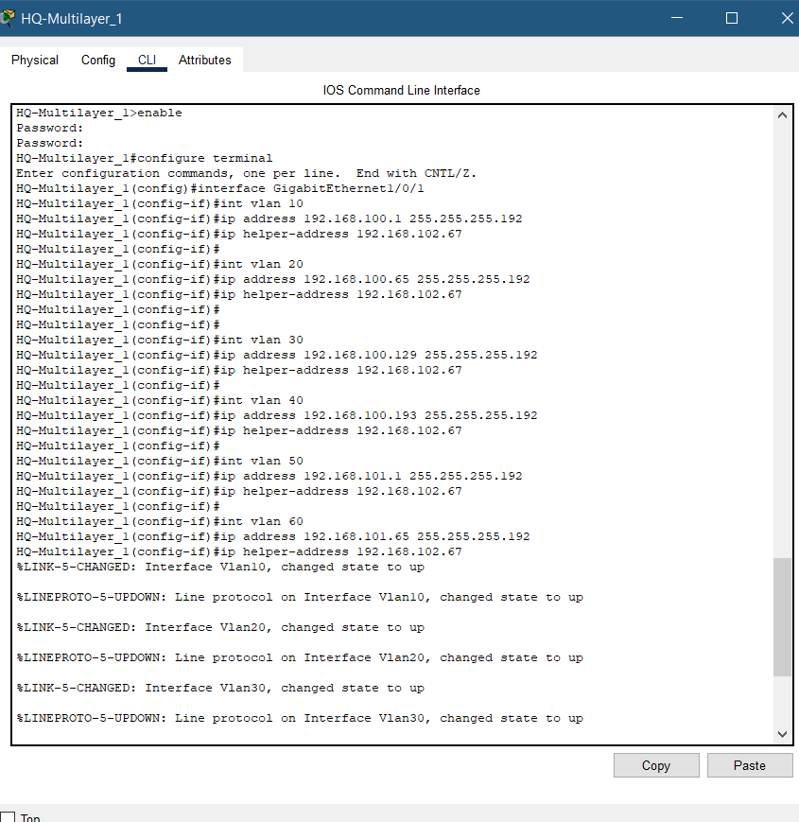
Inter VLAN

Slide 15
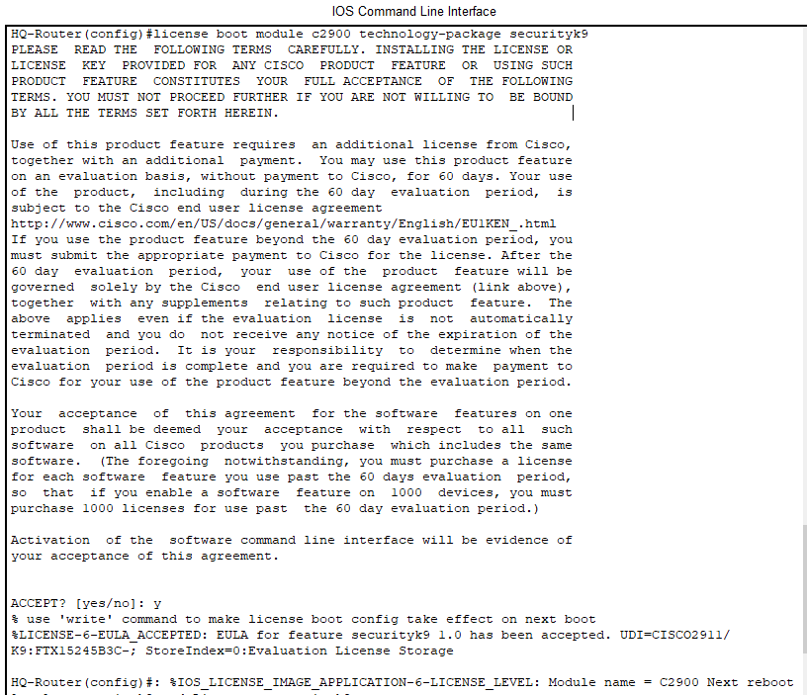

Slide 16
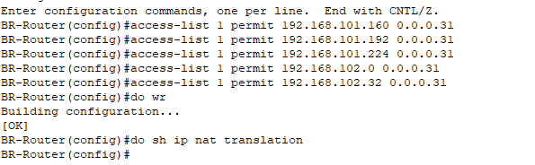
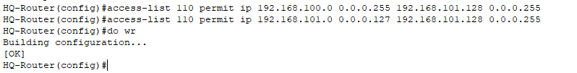
Ip nat/ acces list /clock rate

Slide 17
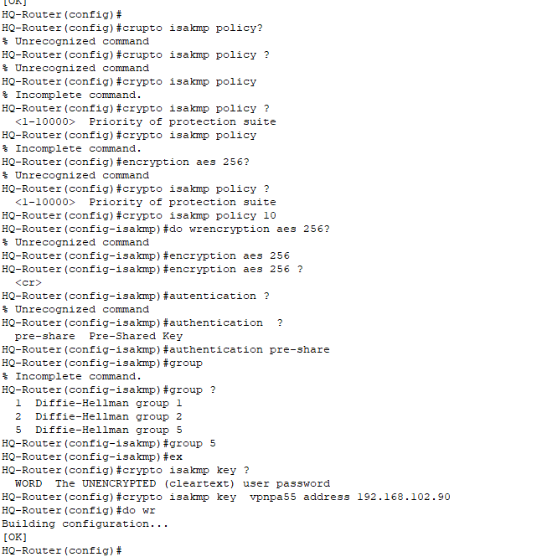
Configuration site to site /ipsec vpn

Slide 18
